Slide 1
UNDERSTANDING CHARACTERISTICS OF GROCERY SHOPPING TRIPS In the Netherlands
Faculty of engineering - technology
Supervisors: BARAN ULAK
JOHAN KOOLWAAIJ
Mobidot
Jean morillo | s2209705

Slide 2
Introduction
Literature review
methodology
Results
Discussion and conclusions

Slide 3
INTRODUCTION
Understanding characteristics of grocery shopping trips in the Netherlands
What are the main characteristics of grocery shopping trips of individuals within the Netherlands?
Frequency of grocery shopping trips and transportation mode choice for this activity
Contribute to the traffic and transportation field by giving a better view of this type of trips

Slide 4
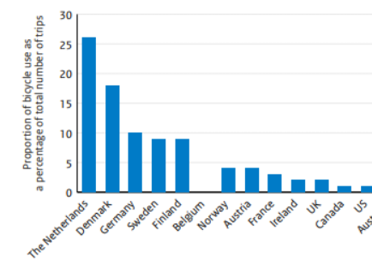
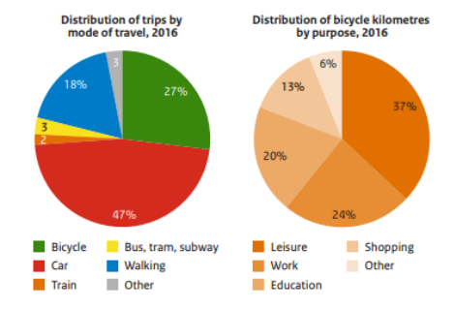
INTRODUCTION
Proportion of bicycle use as a percentage of the total number of trips
Facts about mobility in the Netherlands
Notes:
The Dutch National Travel Survey (NTS) shows that there are more trips with the purpose of shopping (24%) than to work (20%). Of these shopping trips, 72% are related to grocery shopping

Slide 5
Literature review
The Netherlands is the undisputed number one country for cycling
Similar research has been conducted -> using survey data
Studies conducted in different countries (different infrastructure and cultures)
Pattern based on seven-day cycles.
Notes:
Main research question
Literature shows that there are significant differences in travel behavior regarding shopping trips related to the age? Maybe to differeciate between Baby boomers (1946-1964), Generation X: Born 1965-1980 (41-56 years old) Millennials: Born 1981-1996 (25-40 years old) Generation Z: Born 1997-2012 (9-24 years old)

Slide 6
Literature review – Trip’s frequency
Socioeconomic characteristics are more influential than spatial variables
Most of people do their groceries once per month
Inverse association between income and frequency of grocey shopping trips
Notes:
Main research question
Literature shows that there are significant differences in travel behavior regarding shopping trips related to the age? Maybe to differeciate between Baby boomers (1946-1964), Generation X: Born 1965-1980 (41-56 years old) Millennials: Born 1981-1996 (25-40 years old) Generation Z: Born 1997-2012 (9-24 years old)

Slide 7
Literature review – mode choice
Handy observed that income, the presence of children, and their ages influenced mode selection more than gender
Unemployed individuals were less inclined to drive for general shopping than employed individuals
the availability of a vehicle and the price of public transit had a substantial effect on shopping mode choice
Hagberg and Johan argued that the distance to the shop is the most significant element in explaining the mode of transportation
Notes:
Main research question
Literature shows that there are significant differences in travel behavior regarding shopping trips related to the age? Maybe to differeciate between Baby boomers (1946-1964), Generation X: Born 1965-1980 (41-56 years old) Millennials: Born 1981-1996 (25-40 years old) Generation Z: Born 1997-2012 (9-24 years old)

Slide 8
Literature review – modelling approaches
Finding the variables or factors that have an effect on a topic of interest can be done with accuracy using regression analysis.
For count data: Poisson regression and negative binomial regression
Discrete choice models: Multinomial regression analysis (seeks to investigate the choice of an event's value or the perception of its worth among a group of mutually incompatible alternatives)
Notes:
Main research question
Literature shows that there are significant differences in travel behavior regarding shopping trips related to the age? Maybe to differeciate between Baby boomers (1946-1964), Generation X: Born 1965-1980 (41-56 years old) Millennials: Born 1981-1996 (25-40 years old) Generation Z: Born 1997-2012 (9-24 years old)

Slide 9
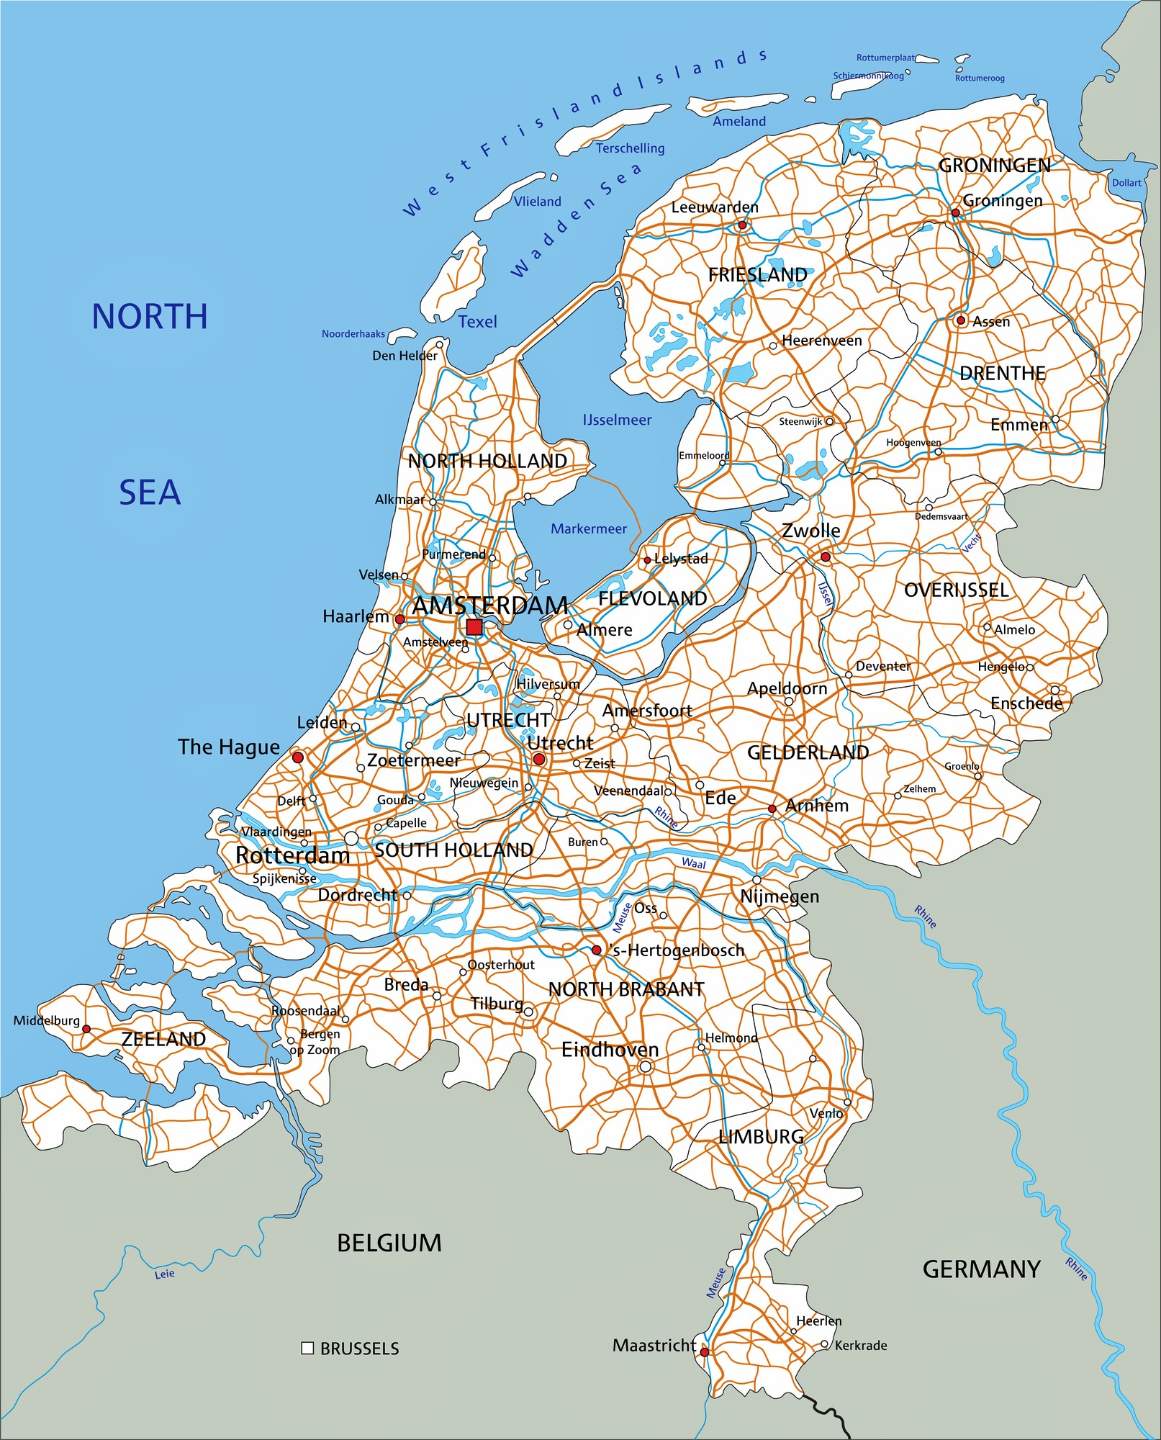
Methodology – study area
The Netherlands' infrastructure is focused on lowering greenhouse gas emissions
Numerous measures have been introduced in an effort to decrease the usage of automobiles
It is assumed that the travel behaviour of individuals in the Netherlands may differ
Notes:
Main research question
Literature shows that there are significant differences in travel behavior regarding shopping trips related to the age? Maybe to differeciate between Baby boomers (1946-1964), Generation X: Born 1965-1980 (41-56 years old) Millennials: Born 1981-1996 (25-40 years old) Generation Z: Born 1997-2012 (9-24 years old)

Slide 10
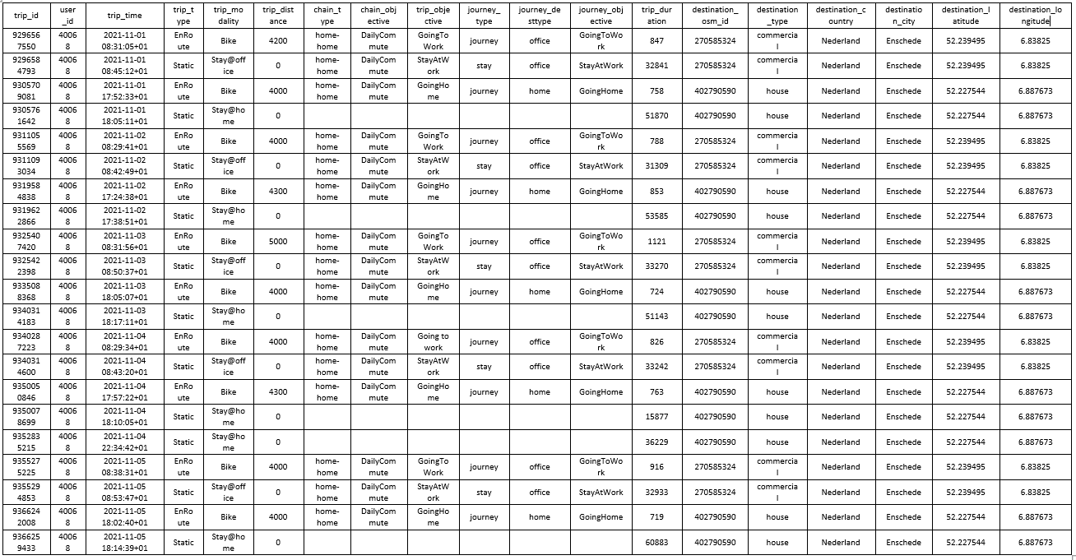
Methodology – DATA
Notes:
Main research question
Literature shows that there are significant differences in travel behavior regarding shopping trips related to the age? Maybe to differeciate between Baby boomers (1946-1964), Generation X: Born 1965-1980 (41-56 years old) Millennials: Born 1981-1996 (25-40 years old) Generation Z: Born 1997-2012 (9-24 years old)

Slide 11
Methodology – DATA
Records about the trips of 7678 users over a period of 91 days (from 28-02- 2022 till 29-05-2022)
Registered by the trip modality
Users do not actively participate in the recognition of their trips
Only users who appear for more than 90% percent of days in the dataset would be taken into consideration
Complex multifunctional location leads to misinterpretation of the destination type
Average shopping time = 32 minutes
Visualization tools: 25 kilometers, 3840 seconds
After cleaning: 3001 users

Slide 12
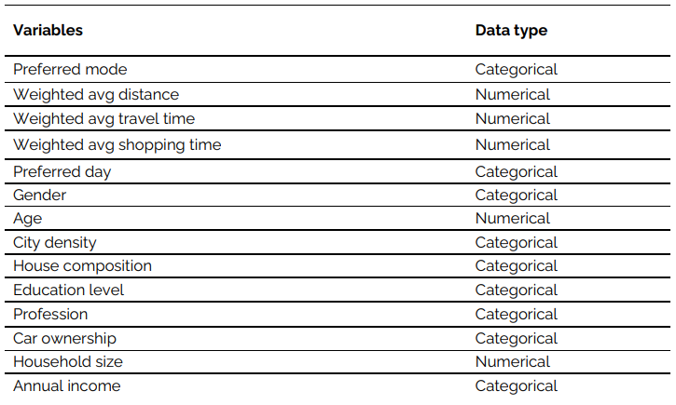
Methodology – DATA
Dependent variable: Number of monthly trips (trip’s frequency) and transportation method used (mode choice)
Independent variables (see figure)
Notes:
Main research question
Literature shows that there are significant differences in travel behavior regarding shopping trips related to the age? Maybe to differeciate between Baby boomers (1946-1964), Generation X: Born 1965-1980 (41-56 years old) Millennials: Born 1981-1996 (25-40 years old) Generation Z: Born 1997-2012 (9-24 years old)

Slide 13
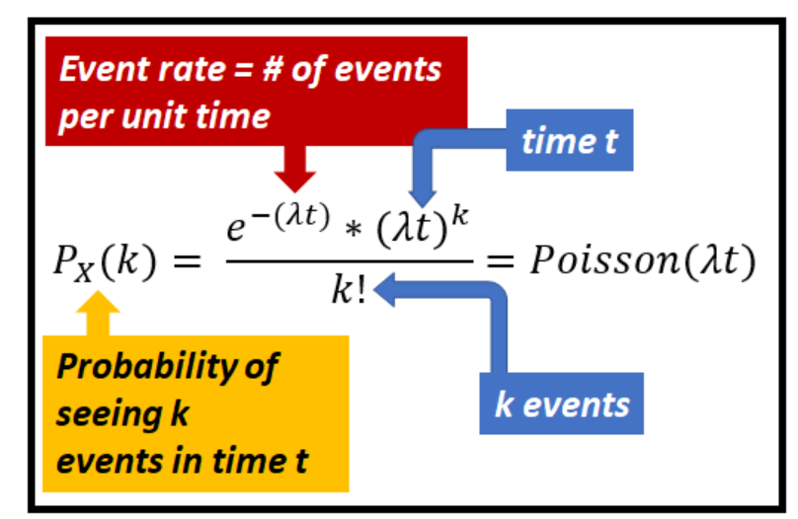
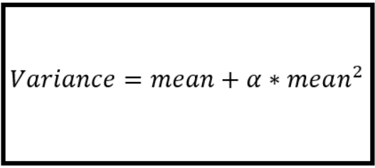
Methodology – Frequency of trips
Poisson or negative binomial regression
Observations must be independent: data needed to be modified
Weighted average was used for distance, trip time and time spent on supermarket
Poisson: mean = variance
Overdispersion is solved by negative binomial regression

Slide 14
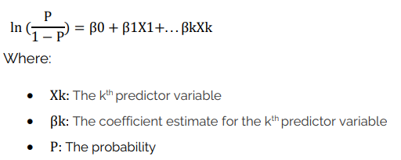
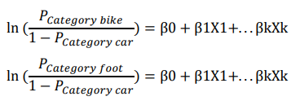
Methodology – MODE CHOICE
Multinomial logit regression is an extent of logistic regression
Probability that an individual chooses an alternative mode of transportation based on the independent variables
Notes:
Main research question
Literature shows that there are significant differences in travel behavior regarding shopping trips related to the age? Maybe to differeciate between Baby boomers (1946-1964), Generation X: Born 1965-1980 (41-56 years old) Millennials: Born 1981-1996 (25-40 years old) Generation Z: Born 1997-2012 (9-24 years old)

Slide 15
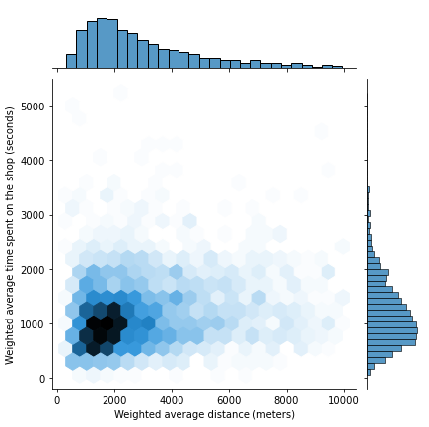
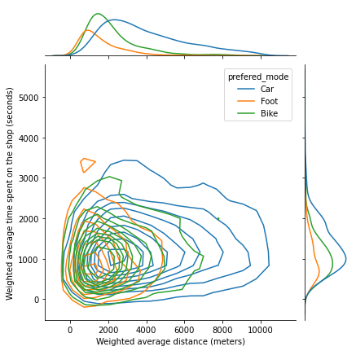
Results
The majority of grocery shopping trips are within a 2- kilometers radius.
Distance has a high influence on the transportation mode chosen by individuals.
15
Notes:
Main research question
Literature shows that there are significant differences in travel behavior regarding shopping trips related to the age? Maybe to differeciate between Baby boomers (1946-1964), Generation X: Born 1965-1980 (41-56 years old) Millennials: Born 1981-1996 (25-40 years old) Generation Z: Born 1997-2012 (9-24 years old)

Slide 16
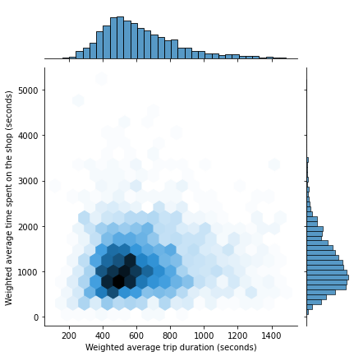
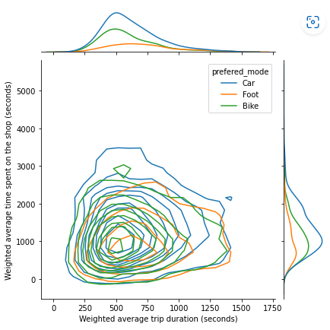
Results
No users are willing to travel more than 25 minutes to buy their groceries
The average time spent for purchasing groceries is 15 minutes
16
Notes:
Main research question
Literature shows that there are significant differences in travel behavior regarding shopping trips related to the age? Maybe to differeciate between Baby boomers (1946-1964), Generation X: Born 1965-1980 (41-56 years old) Millennials: Born 1981-1996 (25-40 years old) Generation Z: Born 1997-2012 (9-24 years old)

Slide 17
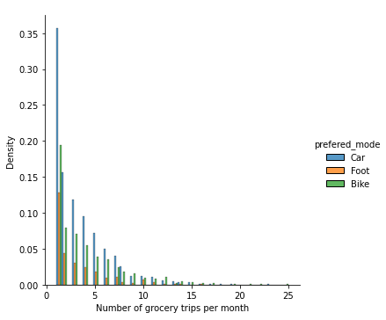
RESULTS
Most individuals buy groceries just once per month
Preferred mode is car
A small number of users do more than 10 trips per month
Notes:
Main research question
Literature shows that there are significant differences in travel behavior regarding shopping trips related to the age? Maybe to differeciate between Baby boomers (1946-1964), Generation X: Born 1965-1980 (41-56 years old) Millennials: Born 1981-1996 (25-40 years old) Generation Z: Born 1997-2012 (9-24 years old)

Slide 18
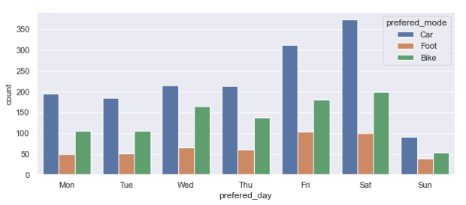
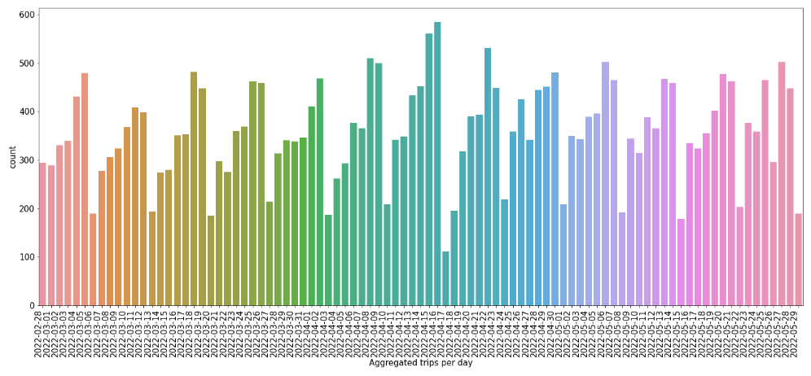
RESULTS
Notes:
Main research question
Literature shows that there are significant differences in travel behavior regarding shopping trips related to the age? Maybe to differeciate between Baby boomers (1946-1964), Generation X: Born 1965-1980 (41-56 years old) Millennials: Born 1981-1996 (25-40 years old) Generation Z: Born 1997-2012 (9-24 years old)

Slide 19
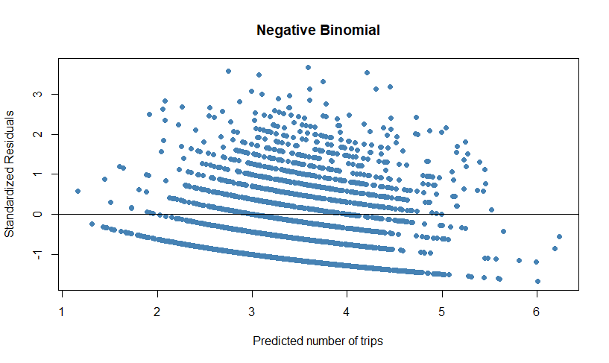
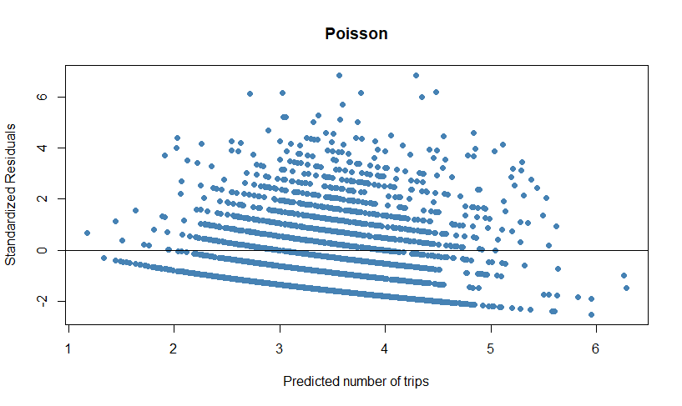
RESULTS
 | Negative Binomial model | Poisson model
Log likelihood | -6.691 | -7.434
AIC | 13432 | 14888

Slide 20
RESULTS – Trip’s frequency
Parameter estimates
term | Estimate | std.error | statistic | p.value | 95% Con. Interval |  | Exp(Estimate)
(Intercept) | 1.6589 | 0.1654 | 10.0280 | 0.0000 | 1.3321 | 1.9861 | 5.2537 | ***
Trip distance | -0.0000 | 0.0000 | -4.7450 | 0.0000 | -0.0001 | 0.0000 | 1.0000 | ***
Trip duration | -0.0001 | 0.0001 | -1.9594 | 0.0501 | -0.0003 | 0.0000 | 0.9999 | .
Time spend on supermarket | -0.0001 | 0.0000 | -3.7399 | 0.0002 | -0.0001 | 0.0000 | 0.9999 | ***
Preferred mode (Car)
Bike | -0.0637 | 0.0372 | -1.7141 | 0.0865 | -0.1373 | 0.0098 | 0.9383 | .
Foot | -0.2502 | 0.0488 | -5.1286 | 0.0000 | -0.3471 | -0.1533 | 0.7786 | ***
City density (High density)
Low density | -0.0530 | 0.0452 | -1.1732 | 0.2407 | -0.1415 | 0.0356 | 0.9484
Medium density | -0.1169 | 0.0351 | -3.3326 | 0.0009 | -0.1858 | -0.0482 | 0.8896 | ***
Notes:
Highlight the typo regarding trip distance

Slide 21
RESULTS – mode choice
Parameter estimates
 | Bike |  |  |  |  |  | Foot
term | estimate | std.error | p.value | Exp(Estimate) | conf.low | conf.high | estimate | std.error | p.value | Exp(Estimate) | conf.low | conf.high
(Intercept) | -1.8536 | 0.0180 | 0.0000 | 0.1567 | -1.8889 | -1.8183 | 0.1210 | 0.0152 | 0.0000 | 1.1286 | 0.0911 | 0.1509
Trip distance | 0.0005 | 0.0000 | 0.0000 | 1.0005 | 0.0004 | 0.0006 | -0.0005 | 0.0001 | 0.0000 | 0.9995 | -0.0006 | -0.0004
Time spend on supermarket | -0.0005 | 0.0001 | 0.0000 | 1.0005 | 0.0004 | 0.0007 | 0.0000 | 0.0001 | 0.9260 | 1.0000 | -0.0002 | 0.0002
Age | -0.0160 | 0.0024 | 0.0000 | 0.9841 | -0.0207 | -0.0114 | -0.0233 | 0.0027 | 0.0000 | 0.9769 | -0.0287 | -0.0180
Household size | -0.0612 | 0.0317 | 0.0535 | 0.9407 | -0.1232 | 0.0009 | -0.0406 | 0.0396 | 0.3056 | 0.9603 | -0.1181 | 0.0370
Preferred day (Monday)
Tuesday | -0.0336 | 0.0179 | 0.0609 | 0.9670 | -0.0687 | 0.0015 | -0.0191 | 0.0100 | 0.0567 | 0.9811 | -0.0387 | 0.0005
Wednesday | -0.3713 | 0.0778 | 0.0000 | 0.6898 | -0.5238 | -0.2189 | -0.1389 | 0.0377 | 0.0002 | 0.8703 | -0.2128 | -0.0650
Thursday | -0.1364 | 0.0737 | 0.0643 | 0.8725 | -0.2810 | 0.0081 | -0.0752 | 0.0366 | 0.0396 | 0.9275 | -0.1469 | -0.0036
Friday | -0.0633 | 0.0707 | 0.3703 | 0.9387 | -0.2018 | 0.0752 | 0.1248 | 0.0411 | 0.0024 | 1.1329 | 0.0442 | 0.2053
Saturday | -0.0727 | 0.0705 | 0.3024 | 0.9299 | -0.2109 | 0.0655 | -0.0249 | 0.0377 | 0.5094 | 0.9754 | -0.0988 | 0.0491
Sunday | -0.1148 | 0.0075 | 0.0000 | 0.8915 | -0.1295 | -0.1001 | 0.1586 | 0.0072 | 0.0000 | 1.1719 | 0.1445 | 0.1728
Gender (Male)
Female | 0.1414 | 0.0705 | 0.0451 | 1.1518 | 0.0031 | 0.2796 | 0.1566 | 0.0418 | 0.0002 | 1.1695 | 0.0746 | 0.2385
City density (High density) |  |  |  | 1.0000
Low density | -0.1356 | 0.0397 | 0.0006 | 0.8732 | -0.2134 | -0.0578 | -0.0316 | 0.0197 | 0.1091 | 0.9689 | -0.0702 | 0.0070
Medium density | -0.2855 | 0.0554 | 0.0000 | 0.7516 | -0.3940 | -0.1770 | 0.1251 | 0.0377 | 0.0009 | 1.1333 | 0.0512 | 0.1991
House composition (With young children)
Adult household | -0.1379 | 0.0540 | 0.0107 | 0.8712 | -0.2438 | -0.0320 | 0.1329 | 0.0371 | 0.0003 | 1.1422 | 0.0603 | 0.2056
With adolescent children | 0.3275 | 0.0096 | 0.0000 | 1.3875 | 0.3088 | 0.3463 | 0.0633 | 0.0056 | 0.0000 | 1.0653 | 0.0524 | 0.0741
Single | -0.0982 | 0.0246 | 0.0001 | 0.9065 | -0.1463 | -0.0501 | -0.4652 | 0.0137 | 0.0000 | 0.6280 | -0.4920 | -0.4384
Notes:
Highlight the typo regarding trip distance

Slide 22
RESULTS – mode choice
Education level |  | Bike |  |  |  |  |  | Foot
High school | 0.1207 |  | 0.0460 | 0.0088 | 1.1283 | 0.0304 | 0.2109 | 0.3087 | 0.0491 | 0.0000 | 1.3617 | 0.2125 | 0.4049
Middle school or below | -0.0243 |  | 0.0557 | 0.6624 | 0.9760 | -0.1334 | 0.0848 | 0.2295 | 0.0637 | 0.0003 | 1.2580 | 0.1046 | 0.3545
Unknown | 10.3353 |  | 0.0001 | 0.0000 | 3.08E+04 | 10.3351 | 10.3354 | 12.3969 | 0.0001 | 0.0000 | 2.42E+05 | 12.3968 | 12.3971
Profession (Employed)
Retired | 0.3004 |  | 0.0625 | 0.0000 | 1.3504 | 0.1778 | 0.4229 | 0.7412 | 0.0448 | 0.0000 | 2.0984 | 0.6535 | 0.8289
Entrepreneur | 0.3547 |  | 0.0089 | 0.0000 | 1.4257 | 0.3373 | 0.3720 | 1.2692 | 0.0066 | 0.0000 | 3.5579 | 1.2563 | 1.2821
Incapacitated | 0.2185 |  | 0.0154 | 0.0000 | 1.2442 | 0.1883 | 0.2486 | 0.7770 | 0.0093 | 0.0000 | 2.1750 | 0.7588 | 0.7952
At home | 0.2371 |  | 0.0240 | 0.0000 | 1.2676 | 0.1900 | 0.2842 | 0.3219 | 0.0104 | 0.0000 | 1.3798 | 0.3015 | 0.3423
Unemployed | 0.0338 |  | 0.0301 | 0.2608 | 1.0344 | -0.0251 | 0.0928 | 0.8720 | 0.0200 | 0.0000 | 2.3916 | 0.8327 | 0.9112
Governmental | -0.8707 |  | 0.0024 | 0.0000 | 0.4186 | -0.8754 | -0.8660 | 0.9613 | 0.0028 | 0.0000 | 2.6152 | 0.9558 | 0.9668
Studying | -0.1814 |  | 0.0097 | 0.0000 | 0.8341 | -0.2005 | -0.1623 | 0.6136 | 0.0063 | 0.0000 | 1.8471 | 0.6012 | 0.6260
Unknown | -0.1813 |  | 0.0010 | 0.0000 | 0.8342 | -0.1833 | -0.1793 | 1.7475 | 0.0010 | 0.0000 | 5.7404 | 1.7457 | 1.7494
Car ownership (Yes)
No | 1.3177 |  | 0.0486 | 0.0000 | 3.7347 | 1.2223 | 1.4130 | 0.4682 | 0.0609 | 0.0000 | 1.5971 | 0.3487 | 0.5876
Unknown | 1.3429 |  | 0.0490 | 0.0000 | 3.8300 | 1.2468 | 1.4389 | 0.4424 | 0.0605 | 0.0000 | 1.5564 | 0.3238 | 0.5610
Annual income (High income)
Modal | -0.2043 |  | 0.0503 | 0.0000 | 0.8152 | -0.3030 | -0.1057 | -0.3600 | 0.0244 | 0.0000 | 0.6977 | -0.4078 | -0.3122
Low income | 0.0854 |  | 0.0722 | 0.2369 | 1.0892 | -0.0561 | 0.2269 | 0.1519 | 0.0399 | 0.0001 | 1.1640 | 0.0737 | 0.2301
Unknown | 0.2609 |  | 0.0464 | 0.0000 | 1.2981 | 0.1699 | 0.3519 | 0.1253 | 0.0263 | 0.0000 | 1.1335 | 0.0738 | 0.1769
Notes:
Highlight the typo regarding trip distance

Slide 23
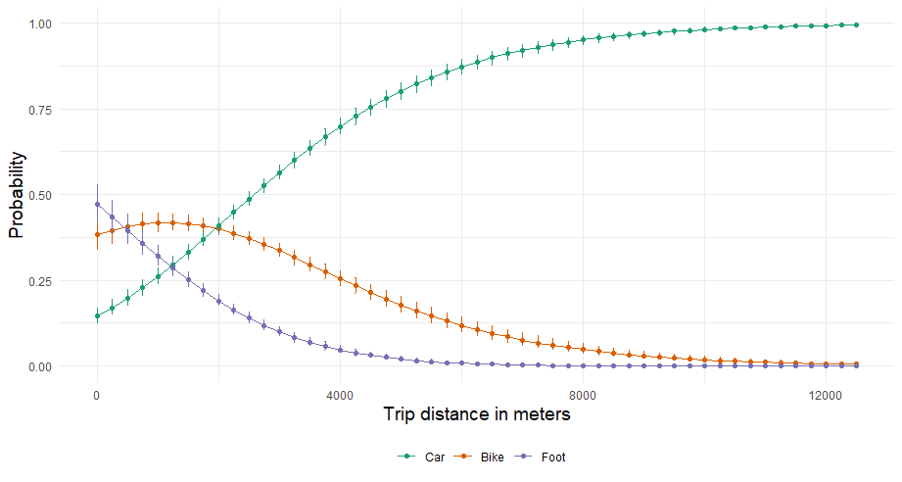
RESULTS – mode choice
Tables are more difficult to understand, visualization of how predictors and outcomes are associated
Notes:
Highlight the typo regarding trip distance

Slide 24
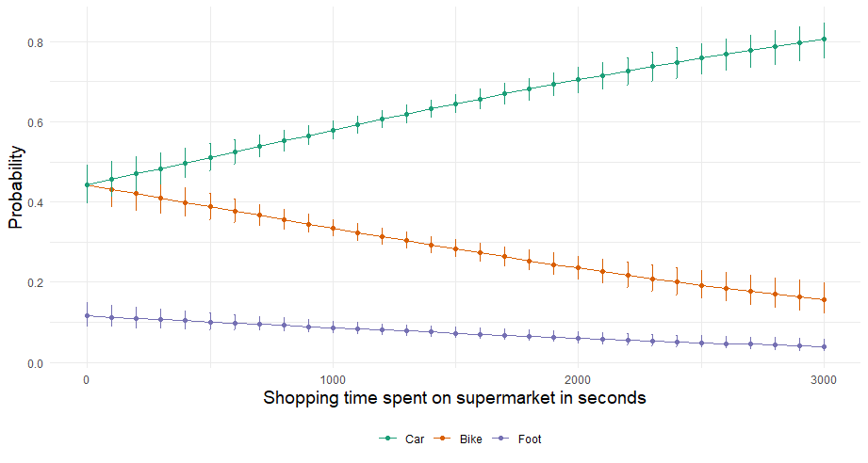
RESULTS – mode choice
Notes:
Highlight the typo regarding trip distance

Slide 25
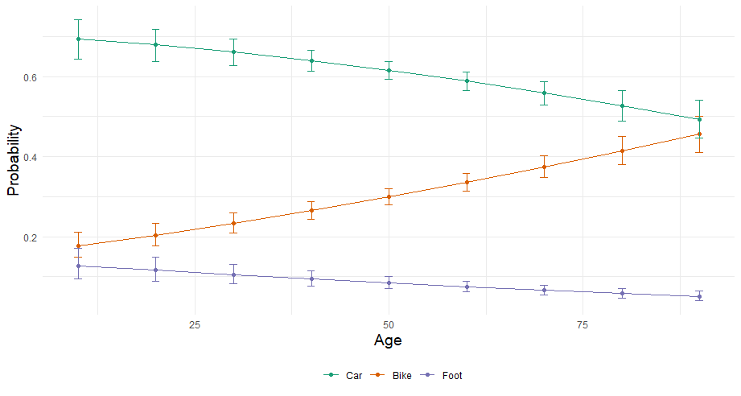
RESULTS – mode choice
Notes:
Highlight the typo regarding trip distance

Slide 26
RESULTS – mode choice
Notes:
Highlight the typo regarding trip distance

Slide 27
Conclusions and recommendations
Grocery shopping follows a seven-day cycle
Saturday is the most popular shopping day since people have more free time to do their groceries
And the majority of users purchase their groceries once per month.
Notes:
Highlight the typo regarding trip distance

Slide 28
Conclusions and recommendations
Grocery shopping frequency increases as the distance to the supermarket decreases
Car continues to be the predominant mode of transportation
There is an inverse link between income and shopping frequency, such that individuals with lower incomes go grocery shopping more often than those with higher incomes.
Notes:
Highlight the typo regarding trip distance

Slide 29
Conclusions and recommendations
As individuals age, their choice for greener modes of transportation grows
Those with a greater income are less likely to pick biking or walking
Individuals living in cities with higher densities are more likely to choose to walk or bike to the supermarket
As more time is spent in the supermarket, the probability of choosing car increases
Notes:
Fixed effect models could lead with panel data. However, more difficult to interpret

Slide 30

Notes:
Highlight the typo regarding trip distance

Slide 31
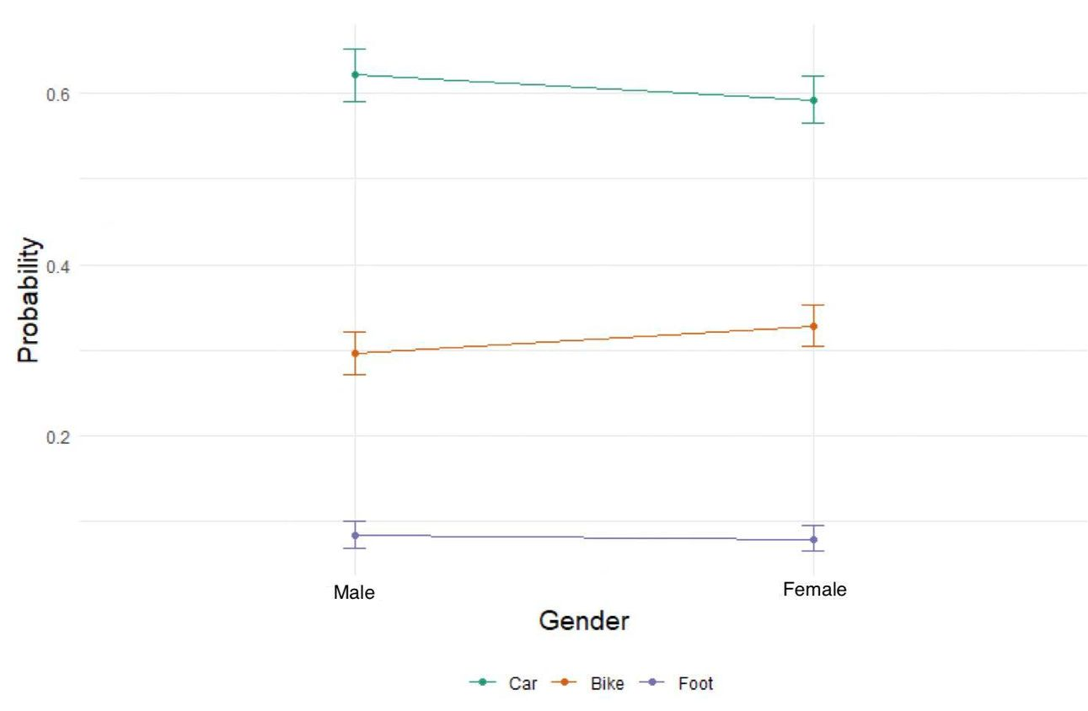
Appendix
Notes:
Highlight the typo regarding trip distance

Slide 32
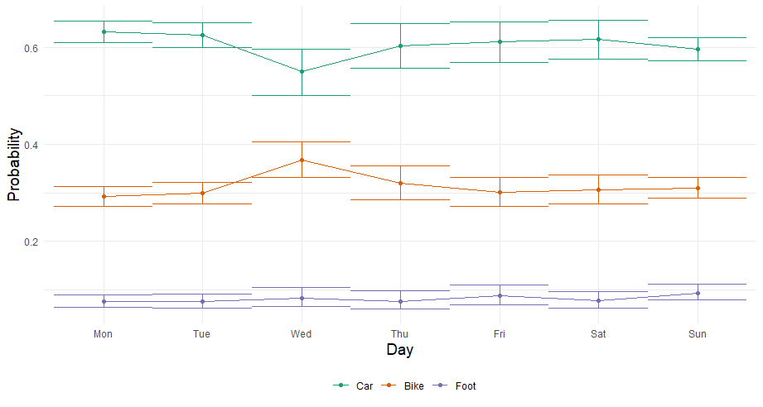
Appendix
Notes:
Highlight the typo regarding trip distance

Slide 33
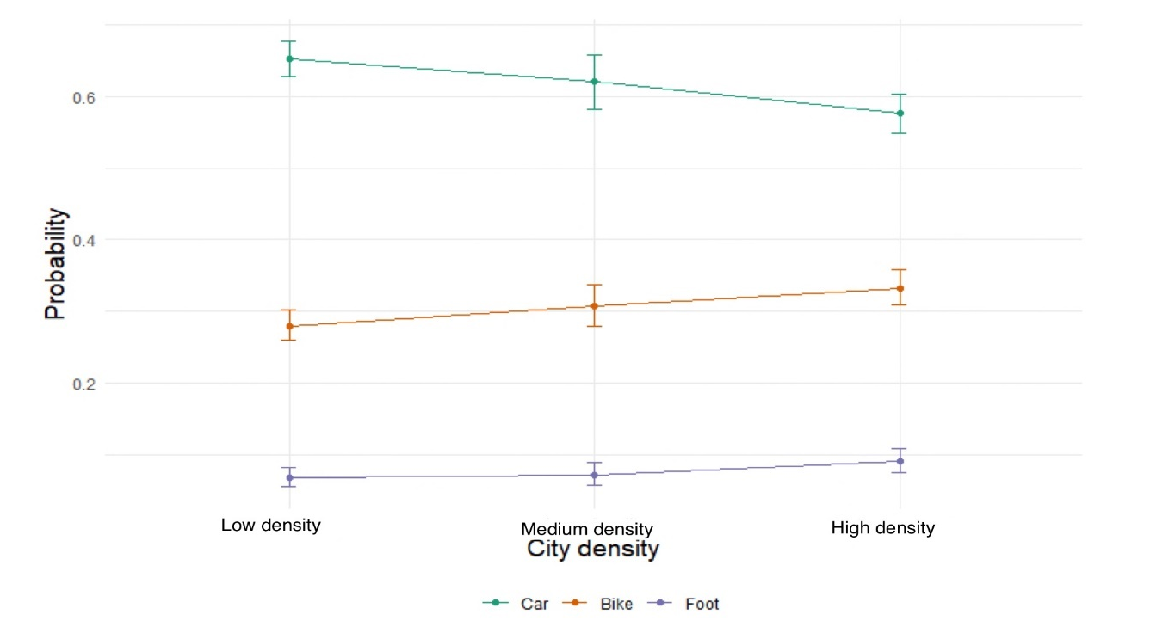
Appendix
Notes:
Highlight the typo regarding trip distance

Slide 34
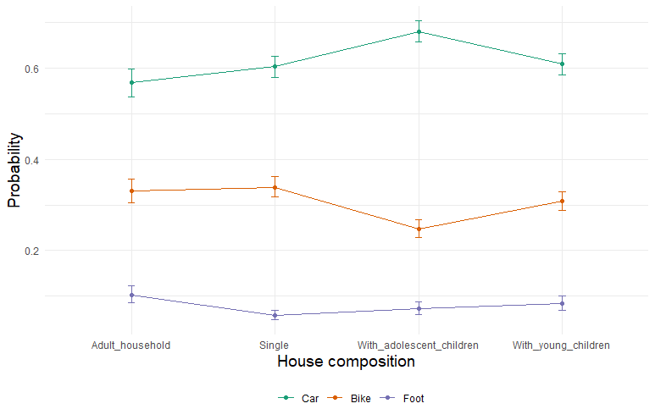
Appendix
Notes:
Highlight the typo regarding trip distance

Slide 35
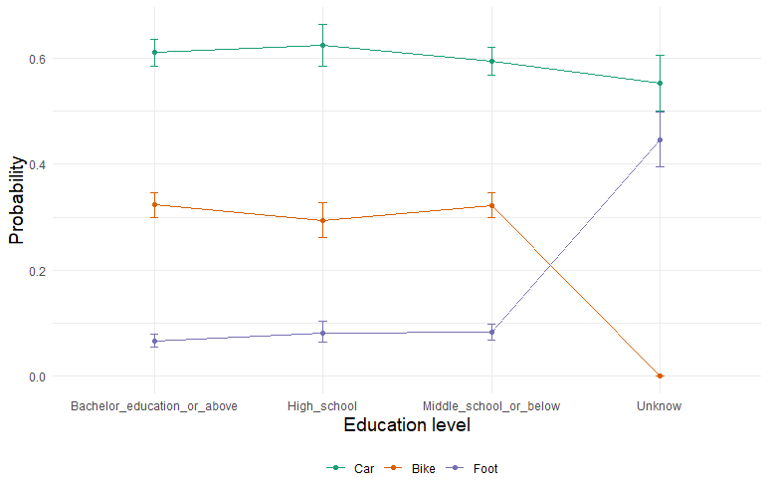
Appendix
Notes:
Highlight the typo regarding trip distance

Slide 36
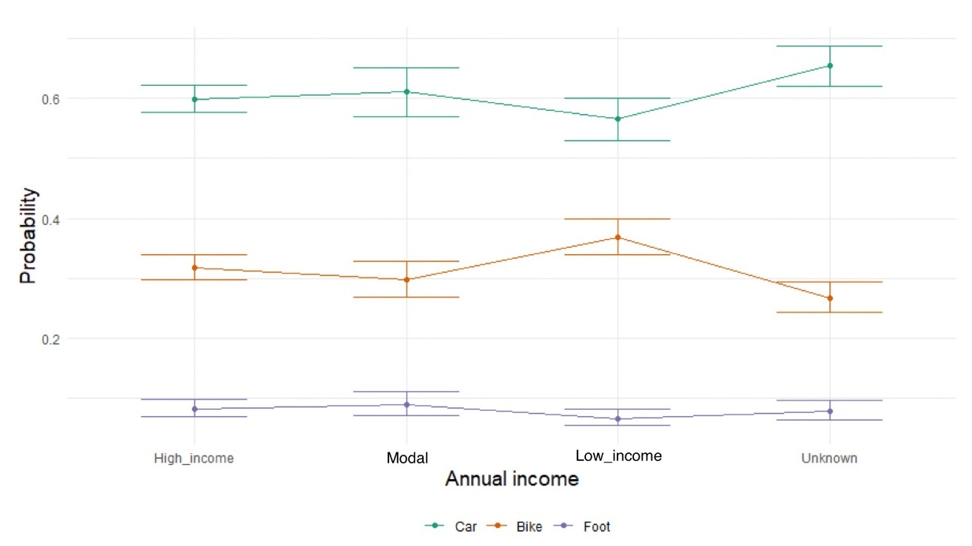
Appendix
Notes:
Highlight the typo regarding trip distance

Slide 37
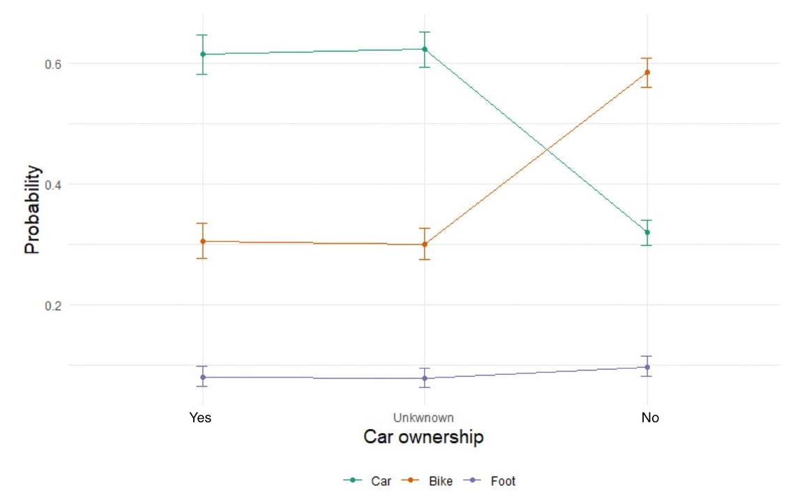
Appendix
Notes:
Highlight the typo regarding trip distance

